Slide 1
ST.ANN’S COLLEGE OF ENGINEERING AND TECHNOLOGY DEPARTMENT OF ELECTRICAL AND ELECTRONICS ENGINEERING PID CONTROLLER BASED FIVE LEVEL INVERTER FOR A GRID INTERFACING SYSTEM
PROJECT MEMBERS:
R.S.VIJAYA VANI 10F01A0295
SK.KHADHAR BASHA 10F01A02A4
N.SRAVANA LATHA 10F01A0282
CH.MALLIKHARJUNA RAO 11F05A0204
PROJECT GUIDE:
Mr.M. NAVEEN BABU M . Tech

Slide 2
ABSTRACT:
This paper proposes a single phase five level inverter for grid connected photovoltaic system , with Pulse width modulated(PWM) technique.
The two reference signals that are identical to each other with an offset that is equivalent to amplitude of the triangular carrier signal used to generate PWM signals for the switches
This proposed inverter offers less total harmonic distortion (THD) and can operate at near unity power factor.
The proposed system was verified through simulation

Slide 3
INTRODUCTION:
Photovoltaic arrays are used in this system for more power generation ,by adopting maximum power tracking system.
The DC power from photovoltaic arrays is applied to the PULSE WIDTH MODULATION(PWM) INVERTER.
PULSE WIDTH MODULATION INVERTER is controlled by PROPORTIONAL –INTEGRAL-DERIVATIVE(PID) controller.
A digital PID current control algorithm is implemented in DSPTMS320F2812
The inverter offers less total harmonic distortion and operates at unity power factor

Slide 4
SINGLE LINE DIAGRAM
T.L D.L
G
GRID
LOAD
PWM
PID controller

Slide 5
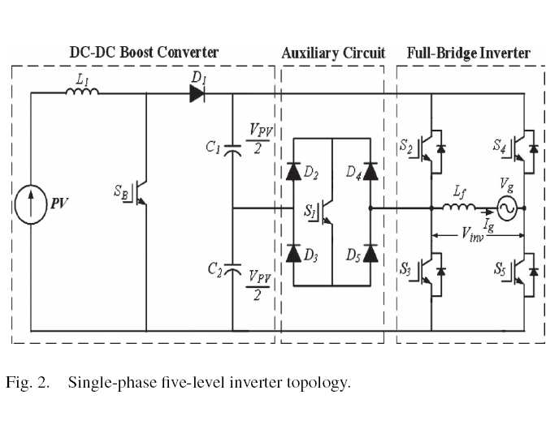
SINGLE PHASE FIVE LEVEL INVERTER TOPOLOGY:

Slide 7
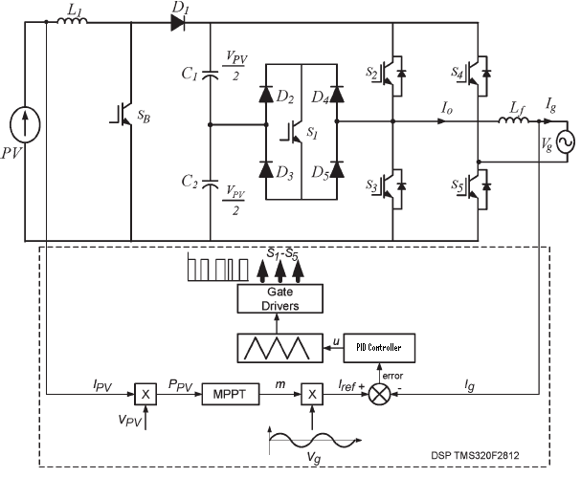
BLOCK DIAGRAM

Slide 8
Photovoltaic inverter ,which is the heart of a pv system ,is used to convert dc power into ac power to be fed into the grid.
PID current control scheme is employed to keep the output current waveform sinusoidal.
A maximum power point tracking method or algorithm , having fast- response characteristics and is able to make good use of the electric power generated in any weather.

Slide 9
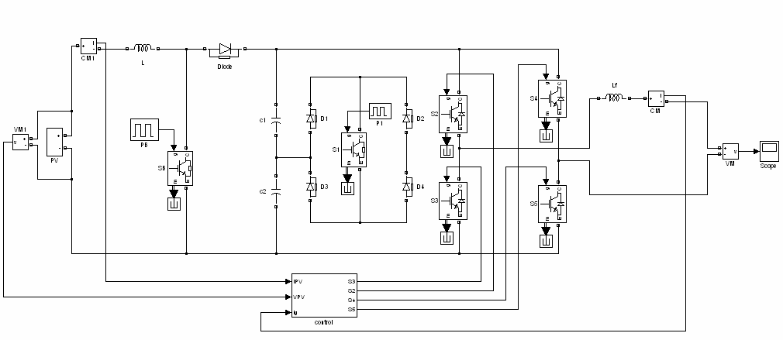
SIMULINK DIAGRAM

Slide 11
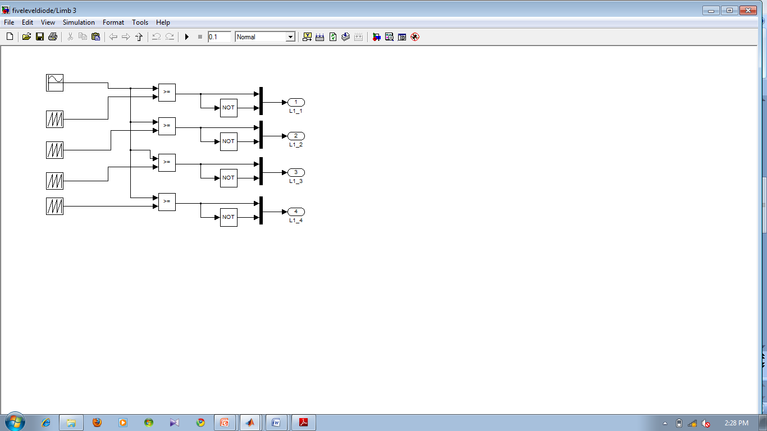
Inbuilt circuit for limb

Slide 12
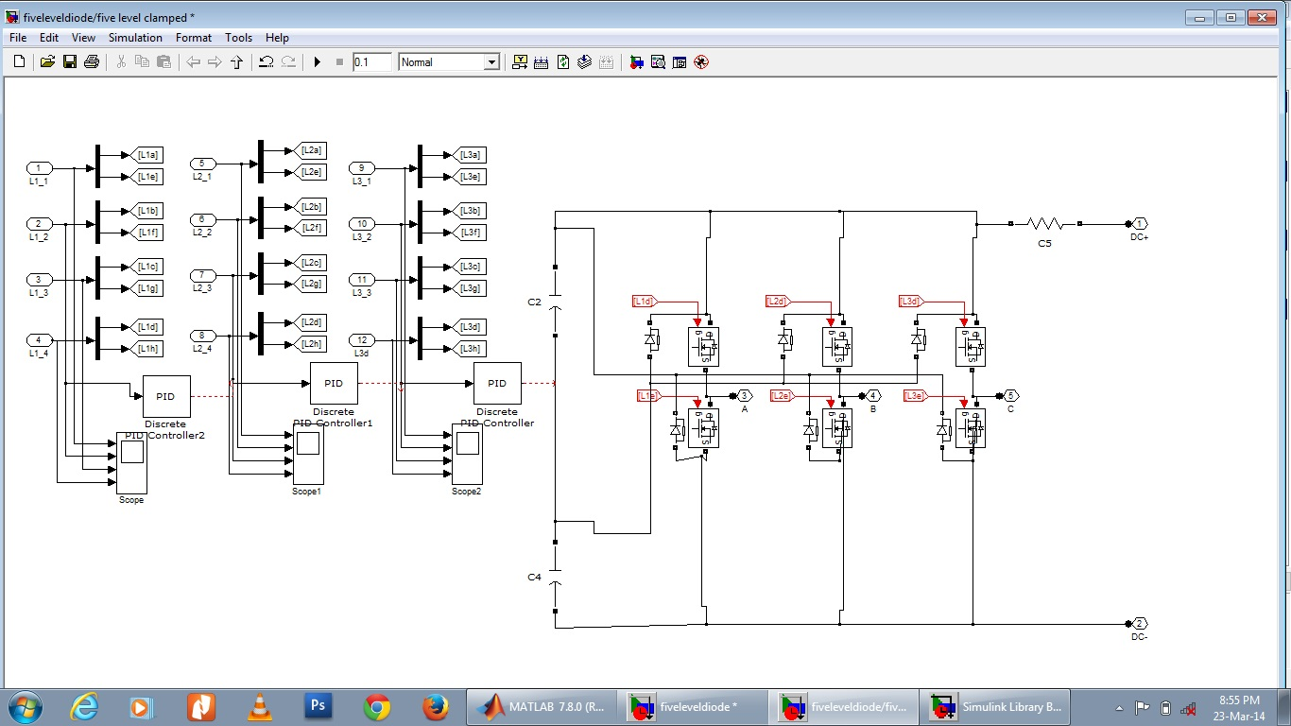

Slide 13
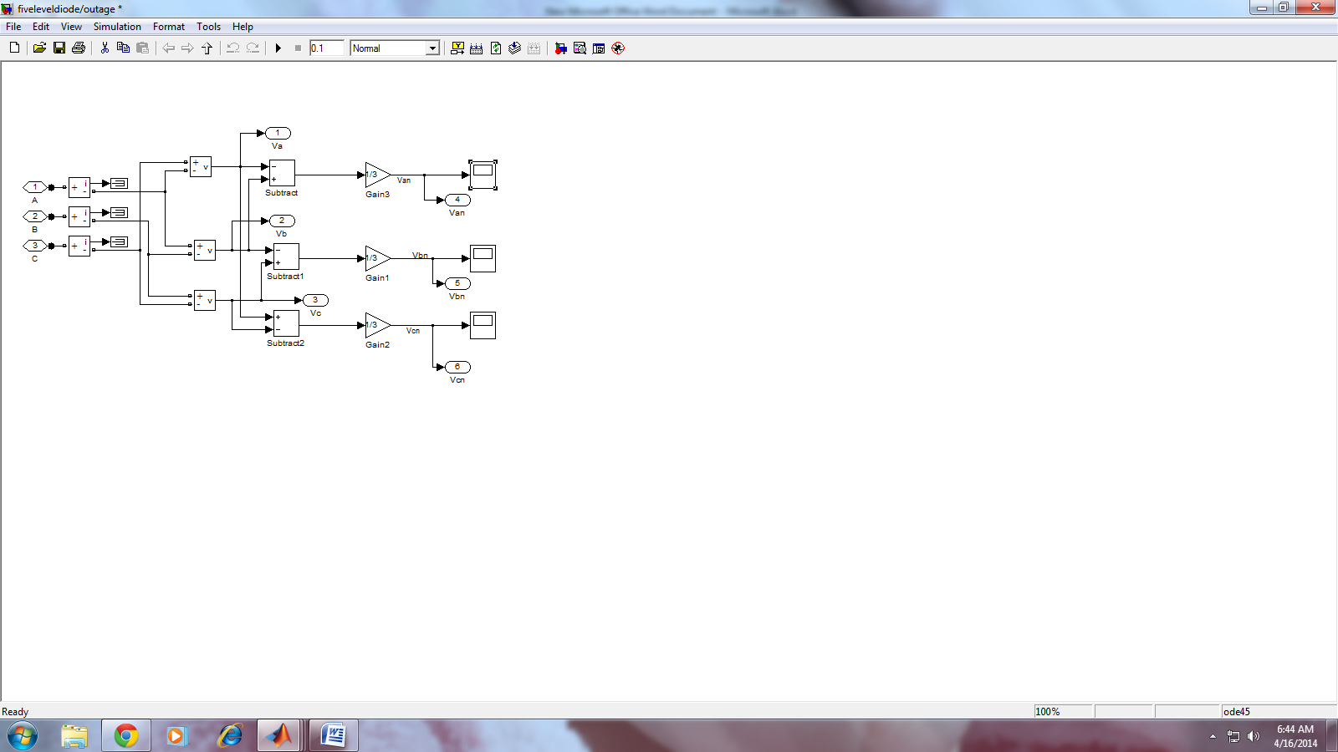

Slide 14
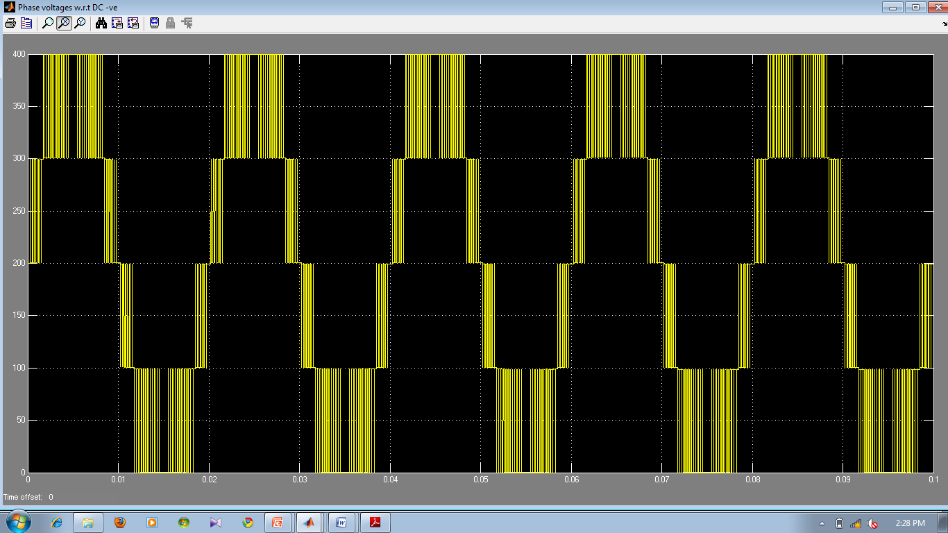

Slide 15
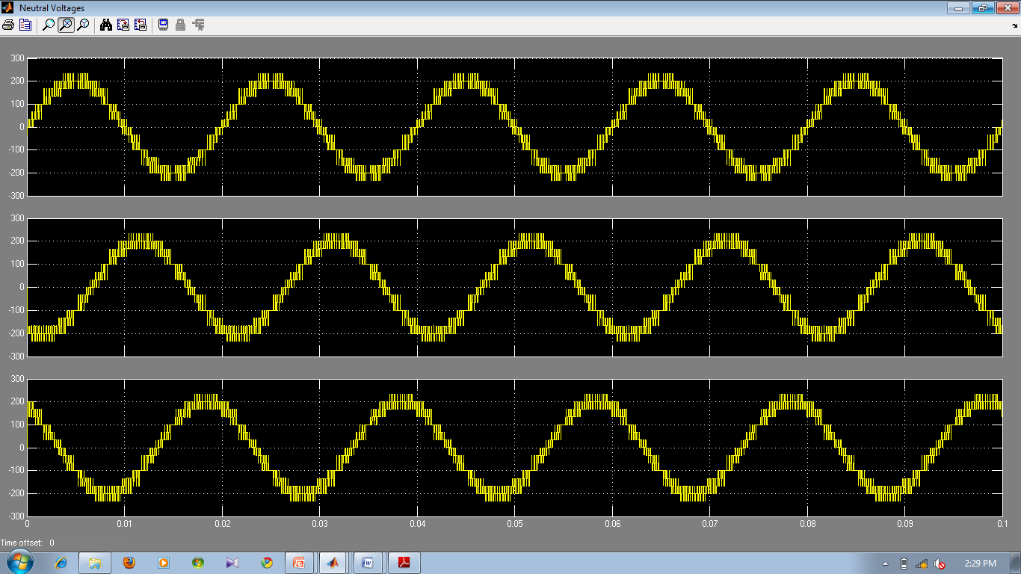
NEUTRAL VOLTGES:

Slide 16
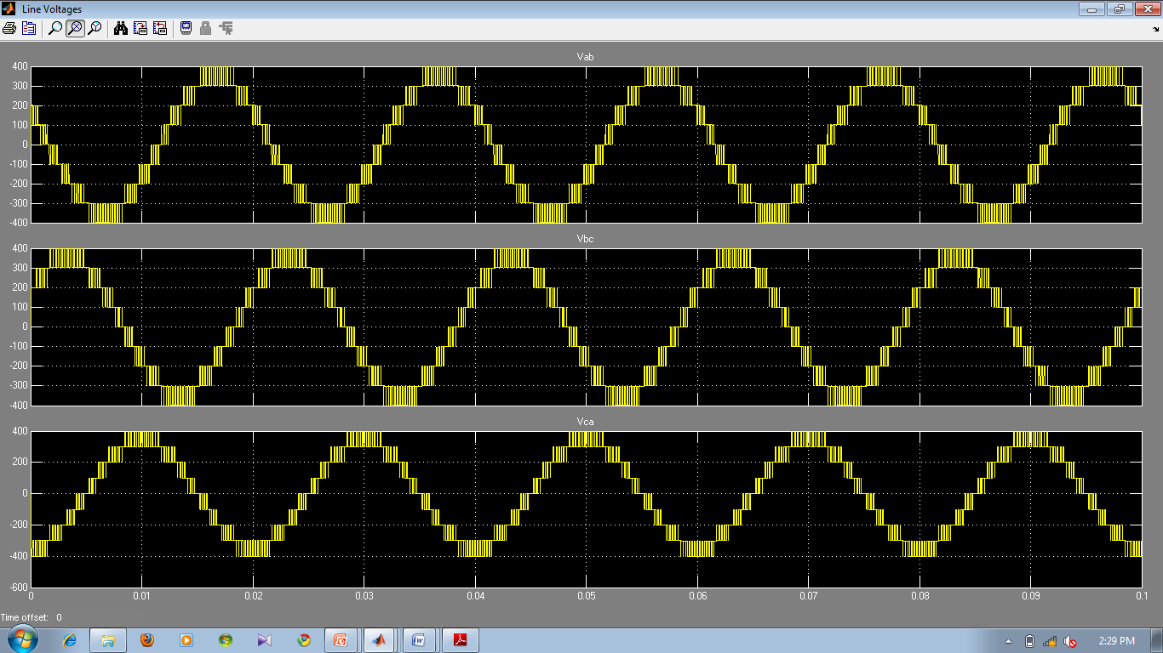
LINE VOLTAGE

Slide 17
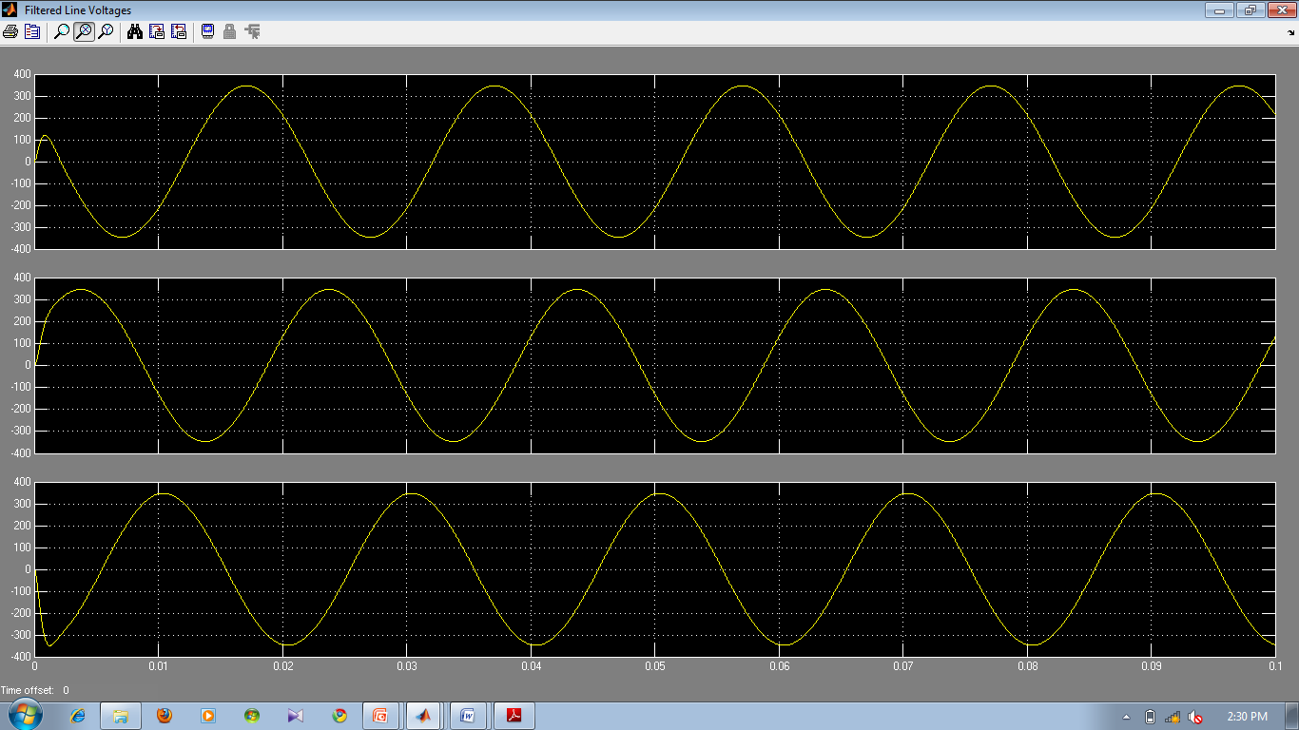
FILTERED LINE VOLTAGES:

Slide 18
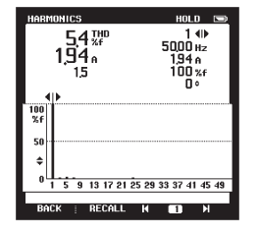
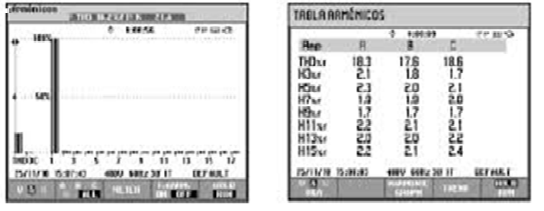
Total Harmonic Distortion for line voltages in graphical and tabular forms

Slide 19
CONCLUSION:
This paper presented a single phase multilevel inverter for PV application
Experimental results indicate that the THD of the five level inverter is much lesser than that of the three level inverter.
The proposed five level diode clamped multilevel inverter has several promising advantages for the use of a three-phase stand-alone photovoltaic system.

Slide 20
Queries….?

Slide 21
THANKQ….!

